Slide 1
Innovative test solution
Provider
- Probe pin DataSheet -

Slide 2
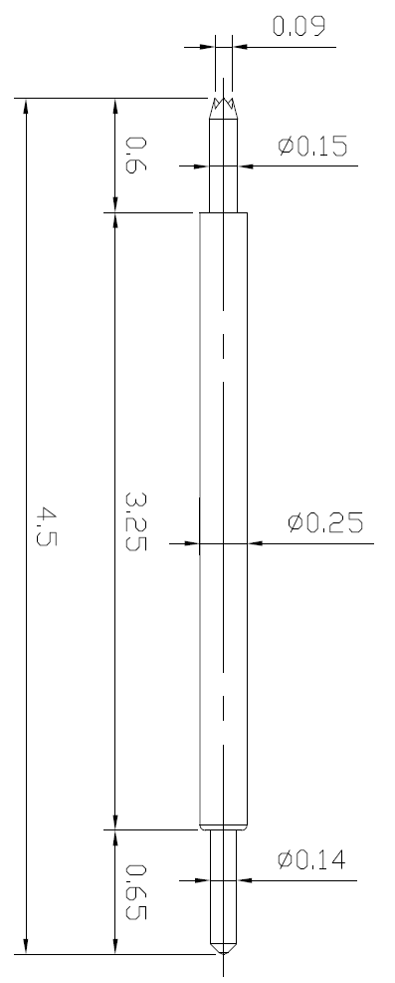
※ POGO type – 0.35 pitch
IVB-SAR-450-025-A211-00
Pitch | 0.35mm
Total Length | 4.5mm
Use Length | 4.1mm
Use Stroke | 0.4mm
Recommended Top Plunger Stroke | 0.15mm
Recommended Bottom Plunger Stroke (Pre-load) | 0.25mm
Max Stroke | 0.5mm
Spring Force at Use Stroke | 20gf at 0.4mm Stroke
Operating Temperature | -50 to 200°C
DC Resistance | Avg. 56.0 mΩ at 0.4mm stroke
Current Rating | 3.0A
Self Inductance | 1.42 nH
Bandwidth @ -3dB | 18.3 GHz
Capacitance | 0.8 pF
Top Plunger | BeCu / Pd
Bottom Plunger | BeCu / Au over Ni
Barrel | Bronze / Au over Ni
Spring | SUS / Au over Ni
Insertion Life | 100,000 cycles at 0.4mm Stroke

Slide 3
Thank you.

